Slide 1
AATCC Test Method 61-2013e(2020)e2
Colorfastness to Laundering: Accelerated

Slide 2
Principle
An accelerated test (45 minutes or less) produces color and surface changes similar to that produced by five hand or home launderings.
May NOT predict real-world staining
Accelerated by:
  Higher temperature
  Low liquor ratio
  Stainless steel balls
Notes:
To evaluate the colorfastness to laundering of textiles which are expected to withstand frequent laundering
Staining is a function of the ratio of colored to un-dyed fabrics, fiber content of fabrics in the wash load, and other end-use conditions that cannot be replicated

Slide 3
Key Points
Temperature
Detergent solution
Low liquor ratio
Stainless Steel or Rubber balls
Notes:
Altering any of these variables will alter the test results.
Abrasive action is a result of the frictional effects of fabric against canister, the low liquor ratio and the impact of the steel/rubber balls on the fabric.

Slide 4
Definitions
laundering, n. of textile materials, a process intended to remove soils and/or stains by treatment (washing) with an aqueous detergent solution and normally including subsequent rinsing, extracting and drying.
colorfastness, n. the resistance of a material to change in any of its color characteristics; to transfer any of its colorants to adjacent materials or both, as a result of the exposure of the material to any environment that might be encountered during the processing, testing, or storage of the material.
Notes:
Note: Results for staining obtained by this method on fabrics dyed to dark shades (navy, black, etc.) that contain a combination of polyester and spandex, or their blends, may not show the full staining propensity of such fabrics in consumer use.
It’s recommended that the staining results obtained by this test not be used for the acceptance testing of such fabrics.

Slide 5
Limitations: Polyester/Spandex
Note: Results for staining obtained by this method on fabrics dyed to dark shades (navy, black, etc.) that contain a combination of polyester and spandex, or their blends, may not show the full staining propensity of such fabrics in consumer use.
Notes:
This is due to a dyeing issue, as dyes for polyester may not be as colorfast on spandex.

Slide 6
Accelerated Laundering Tests Correlations
Test No. | Temp. | Total Volume | % Powder Deterg. | % Liquid Deterg. | % Chlorine | Steel Balls | Rubber Balls | Time | Test Correlation
1A | 40C 105F | 200 mL | 0.37% | 0.56% | None | 10 | 0 | 45 min | 5 typical careful hand launderings @ 40±3C (105±5F)
1B* | 31C 88F | 150 mL | 0.37% | 0.56% | None | 0 | 10 | 20 min | 5 typical careful hand launderings @ 27±3C (80±5F)
2A | 49C 120F | 150 mL | 0.15% | 0.23% | None | 50 | 0 | 45 min | 5 home machine launderings @ 38±3C(100±5F)
3A | 71C 160F | 50 mL | 0.15% | 0.23% | None | 100 | 0 | 45 min | 5 home machine launderings @ 60±3C(140±5F)
4A | 71C 160F | 50 mL | 0.15% | 0.23% | 0.015% | 100 | 0 | 45 min | 5 home machine launderings @ 63±3C(145±5F) w/Bleach
5A | 49C 120F | 150 mL | 0.15% | 0.23% | 0.027% | 50 | 0 | 45 min | 5 home machine launderings @ 49±3C(120±5F)w/Bleach
Notes:
With six options to choose from, it may be difficult to determine which one best suits your fabric’s end use.
Each option, 1A-5A, correlates with a “real world” end use. The severity of each 45 (or 20 min. – Option 1B*) min. laundering, whether is it hand or home, depends on the test option chosen.
Test option 1A is for evaluating the colorfastness of textiles that are expected to withstand repeated hand launderings at a low temperature. Specimens will show a color change comparable to 5 hand launderings after the testing time of 45 min. @ a temp. of 40 +/- 3 degrees Celsius.
Test option 1B shows colorfastness results similar to textiles that are expected to withstand repeated hand laundering at cool temperatures. Specimens will show a color change comparable to 5 hand launderings after the testing time of 20 min. @ a temp. of 27 +/- 3 degrees Celsius.
*This option is the first test that includes the use of the standard liquid detergent and the use of rubber balls instead of stainless steel balls.
Test option 2A shows colorfastness results similar to textiles that are expected to withstand 5 home launderings at 38 +/- 3 degrees Celsius.
Test option 3A is for evaluating colorfastness to washing textiles considered washable under vigorous conditions. It produces similar results to 5 home machine launderings at 60 +/- 3 degrees Celsius.
Test option 4A has conditions similar to that of 3A with the only difference being that it incorporates the use of chlorine as a bleaching agent. Specimens subjected to this test should show a color change similar to 5 home machine launderings at 63 +/- 3 degrees Celsius with 3.74g per L (0.50 oz/gal) of 5% available chlorine per 3.6kg (8 lb) load.
Test option 5A is similar to test 2A but 5A, like 4A, also incorporates the use of chlorine. Specimens subjected to test 5A should show color change similar to that produced by 5 home machine launderings at 49 +/- 3 degrees Celsius with 200 +/- 1 ppm available chlorine.
Note: With tests 4A and 5A it is important to remember not to use a multi-fiber strip because the wool on the strip absorbs the chlorine leaving very little for bleaching action. However, the wool can be removed from the multifiber strip before testing to eliminate this effect.

Slide 7
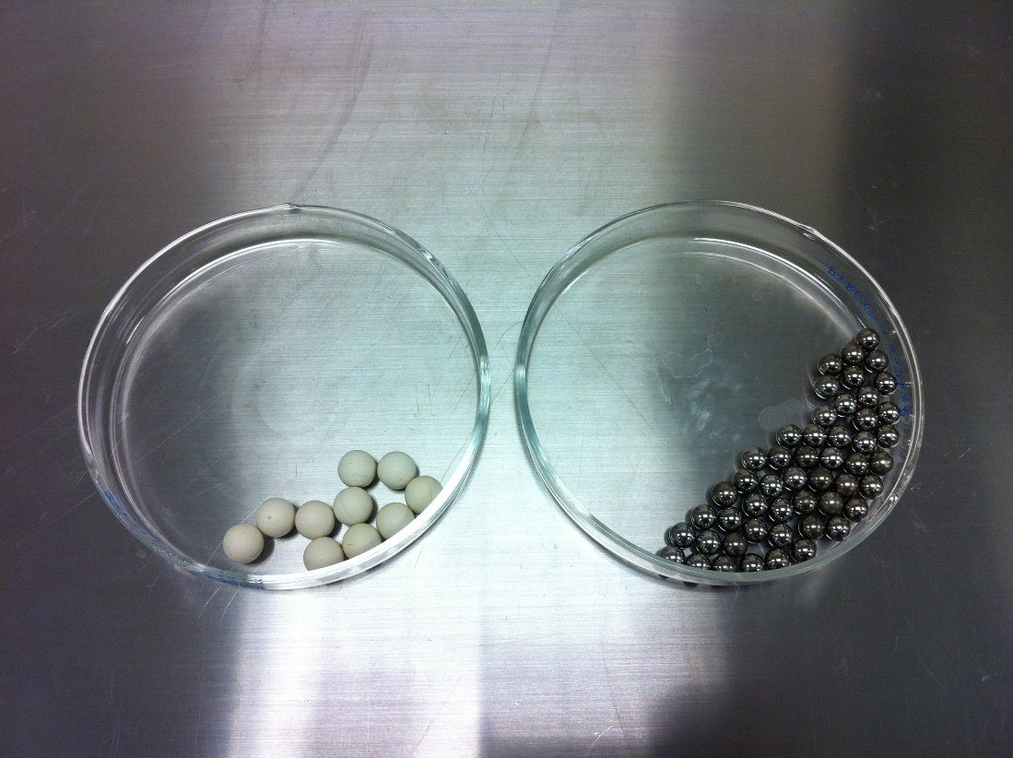
Apparatus
Accelerated laundering machine
  Rotates closed canisters in a thermostatically controlled environment
  Adapter plates hold canisters in machine
Stainless steel canisters with neoprene gaskets (black)
  Type 1 - 500 mL for 1A test
  Type 2 - 1200 mL for all other tests
Teflon fluorocarbon gaskets (white)
Balls
  Stainless Steel for all other tests
  Rubber balls for Test 1B*
Notes:
Note: Most accelerated laundering machines are also equipped with a pre-heater/storage module.

Slide 8
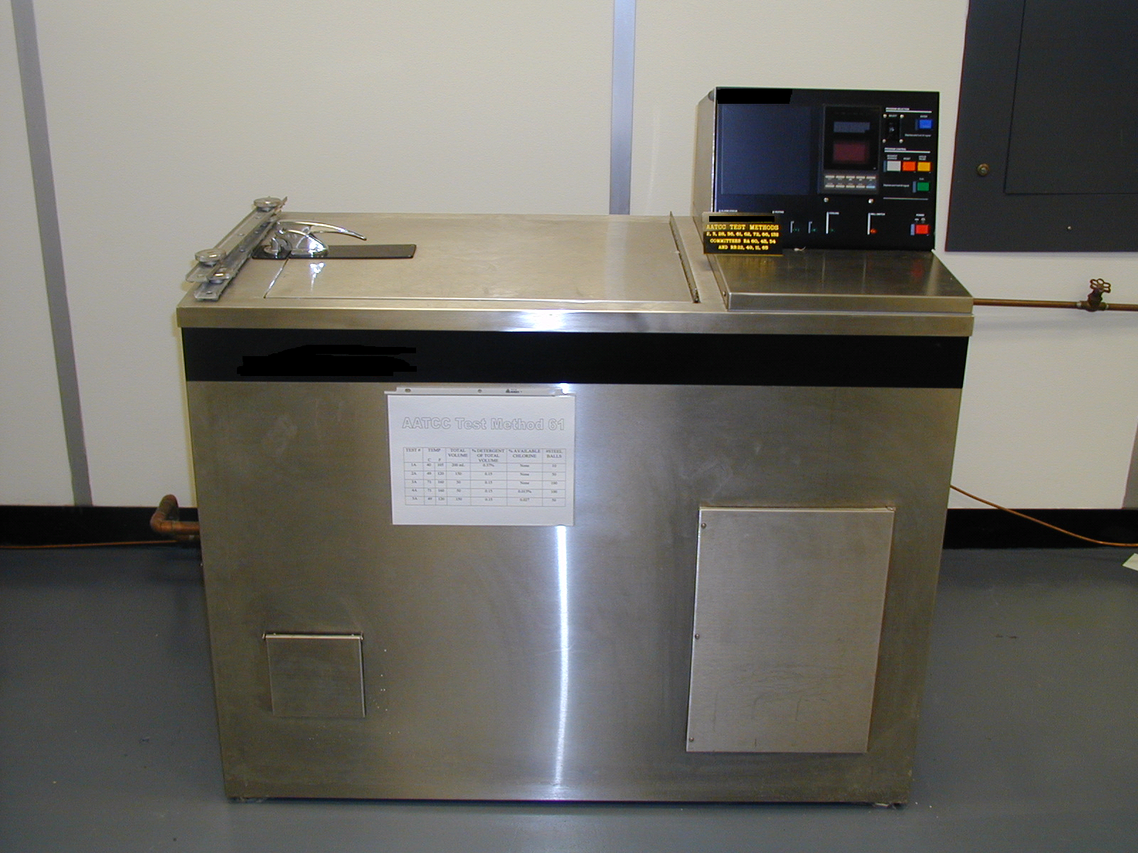
Accelerated Laundering Machine
Notes:
*A laundering machine for rotating closed canisters in a thermostatically water bath at 40

Slide 9
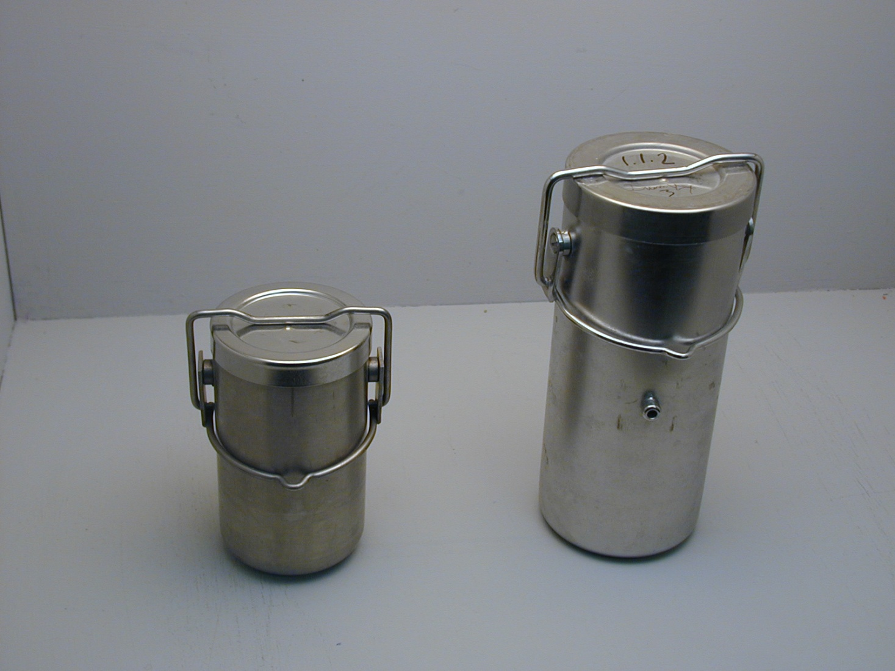
Type I & Type II Canisters
Notes:
500 mL canister (Type I for option 1A) on left
1200 mL canister (Type II for all other options) on right

Slide 10
Apparatus
Scales for rating test results
  Gray Scale for Color Change
  AATCC 9-step Chromatic Transference Scale
  Gray Scale for Staining

Slide 11
Reagents and Materials
Multifiber (1A, 1B, 2A, optional for 3A)
Bleached Cotton Test Fabric (for knits; opt. for 3A staining)
Distilled or Deionized Water
AATCC Standard Reference Detergent
  Powder
  With or without brightener
4A, 5A:
Sodium Hypochlorite (NaOCl)
Sulfuric Acid (H₂SO₄) 10%
Potassium Iodide (KI) 10%
Sodium Thiosulfate (Na₂S₂O₃)

Slide 12
Specimens
1A
  50 x 100 mm (2.0 x 4.0 in)
  Attach multifiber to face
1B, 2A
  50 x 150 mm (2.0 x 6.0 in)
  Attach multifiber to face
3A
  50 x 150 mm (2.0 x 6.0 in)
  Heat-sealed multifiber OR White Cotton Test Cloth
4A, 5A
  50 x 150 mm (2.0 x 6.0 in)
  NO staining cloth
Notes:
No multi-fiber strip in 4A & 5A because the wool on the strip absorbs the chlorine, leaving very little for bleaching action. (The wool can be removed from the multifiber strip before testing to eliminate this effect.)
3A acetate, nylon, poly, acrylic staining disregarded unless known to be present in the final garment

Slide 13
Specimens
Wool
Acrylic
Polyester
Nylon
Cotton
Acetate
Notes:
8 mm bands parallel to length, wool at right
15 mm bands parallel to width, wool at top

Slide 14
1A
1B/2A
3A
4A/5A

Slide 15
Special Specimens
For knits, attach cotton test cloth to back to prevent curling
For pile fabrics, attach multifiber at top, with pile pointing down
For yarns
  Knit a specimen
  or
  Attach white test fabric at each end of skein
Notes:
Staple or sew test cloth on 4 edges

Slide 16
Specimen Preparation
Cut sample according to test requirements
Attach multifiber or adjacent fabric
  Position depends on the size multifiber being used.
  8 mm filling bands: wool strip on right (fiber bands parallel to lengthwise direction of the specimen)
  15 mm filling bands: wool strip at top to avoid fiber loss (fiber bands parallel to the widthwise direction of the specimen)
Notes:
Cut the samples according to test requirements; Table 1 in TM
(If there is time to include only!!)
Attach multifiber or adjacent fabric:
For bands 8mm wide or with bleached cotton test fabric prepare pieces with a 50mm (2”) square of multifiber or bleached cotton test fabric sewn or stapled along one 50mm edge of the test specimen and in contact with the face of the material.
For bands 15mm (0.6”) wide prepare pieces with a 50x100mm rectangle of multifiber test fabric sewn or stapled, centered along one 100mm (4”) or 150mm (6”) edge of the test specimen and in contact with the face of the material.

Slide 17
Detergent Solutions
1993 AATCC Standard Reference Powder Detergent
  - With OR without optical brighteners
Notes:
No longer available:
2003 AATCC Standard Reference Liquid Detergent
- With OR without optical brighteners

Slide 18
Detergent Solutions
1A, 1B: Mix 3.7 g powder detergent (5.6 g liquid detergent) with 1 L distilled water until dissolved
2A, 3A, 4A, 5A - Mix 1.5 g powder detergent (2.3 g liquid detergent) with 1 L distilled water until dissolved
  4A: Add 0.015% available chlorine.
  5A: Add 0.027% available chlorine.
Notes:
Ex. Prepare 1000mL (1L) of a 0.37% solution
Grams of Chemical = (1000mL) x (0.37%/100)
= 3.7g

Slide 19
Chlorine Solution Titration
2.0 g of liquid sodium hypochlorite
Dilute with 50 mL deionized water
Add 10 mL 10% sulfuric acid
Add 10 mL 10% potassium iodide (the solution is brown)
Titrate with 0.1N sodium thiosulfate until colorless
Notes:
*Demonstration the Titration process here.
Take initial and final burette readings and find total mL of sodium thiosulfate (Final – Initial)
% Sodium Hypochlorite equation on next slide!

Slide 20
Chlorine Solutions
Calculation
  % sodium hypochlorite
= (mL Na₂S₂O₃)(0.1N)(0.03722) x 100
(2.00g NaOCl)
The factor 0.03722 is derived by multiplying the molecular weight of NaOCl (4.45 g/mol) by 0.001 (mL to L conversion) and dividing by 2 (mols of thiosulfate per hypochlorite).
Notes:
Once you find % sodium hyphchlorite you can solve for 4A and 5A total grams of bleach needed.

Slide 21
Chlorine Solutions
4A - Prepare .0015% available chlorine solution. For 1 L the amount of sodium hypochlorite bleach solution to dilute is determined by:
159.4 / % NaOCl = g of bleach to add
% NaOCl is determined by titration with 0.1N Sodium thiosulfate.
Notes:
5mL of 1500ppm available chlorine solution from titration!
Ex. –initial burette reading = 0mL
-final burette reading = 30.7mL
-Total mL of Na₂S₂O₃ (final – initial) = 30.7mL
So…% Sodium hypochlorite = (30.7mL ₂S₂O₃) (0.1N) (0.03722) x 100 = 5.71% NaOCl
2.0g NaOCl
0.03722 <- # derived in Notes sec. on page 94!!
So… 159.4 (constant) / 5.71% NaOCl = 27.92g of bleach
*Reminder that titration was done in demo.

Slide 22
Chlorine Solutions
5A - determine the amount of stock sodium hypochlorite bleach solution to dilute:
4.54 / % NaOCl = grams to add
% NaOCl is determined by titration with 0.1N Sodium thiosulfate.
Notes:
Correct amount of bleach determined from titration and formula.
Ex. 4.54 (constant) / 5.71% NaOCl = 0.79g of bleach

Slide 23
Final Detergent Solutions
1A & 1B – Add the detergent solution to the canister (0.37%=1000mL+3.7g powder detergent)
2A & 3A– Add the detergent solution to the canister (0.15%= 1000mL+1.5g powder detergent)
Notes:
Ex. Prepare 1000mL (1L) of a 0.37% solution
Grams of Chemical = (1000mL) x (0.37%/100)
= 3.7g

Slide 24
Final Detergent/Chlorine Solutions
4A – Add 45 mL of detergent solution to canister. Add 5 mL of .015% available chlorine solution to the canister for a total of 50 mL
5A – Weigh correct amount of bleach into graduated cylinder and add detergent solution to make a total volume of 150 mL

Slide 25
Procedure
Set temperature in laundering machine
Add detergent (& chlorine) solution to canister
Add stainless steel (or rubber in Option 1B) balls to canister
Load canister in machine
  Balance canisters on shaft
  Mount Type 1 vertically
  Mount Type 2 horizontally
Preheat detergent solution
Add test specimen
Notes:
White teflon fluorocarbon gasket can be inserted b/w the neoprene gasket (black) and the top of each canister to prevent contamination of the wash solution by the neoprene.
Type I canisters placed vertically in machine; Type II canisters placed horizontally in machine.
Place all in a manner so that the top of each canister hits the water first and each rack is balanced!!
Allow machine to run w/o samples in canisters until preheated (atleast 2 minutes).
*Mention: Some units have a separate preheater module.
Once preheated, add samples one at a time and clamp cover of canisters at the same time to assure equal pressure.
Run machine @ 40 +/- 2 rpm for 45 minutes

Slide 26
Procedure
Run test
Remove canisters after test cycle is completed
Empty contents into beaker
Rinse test specimen 3 times at 40 ± 3°C for 1 minute periods
Blot excess water
Dry specimens in oven, air dry, or tumble dry in nylon mesh bag
Notes:
Remove each sample into separate beakers
Rinse specimens 3 times for 1 min. periods in distilled or deionized water.
Dry specimens in oven (no more than 71 degrees Celsius or 160 degrees F), air dry or tumble dry in nylon mesh bag in an automatic tumble dryer @ normal cycle (60-71 degrees C)

Slide 27
Evaluation
Allow specimens to condition at 65 ± 5% relative humidity and 21 ± 2°C for 1 hour before evaluating.
Prepare specimens and multifiber for evaluation.
  Trim unraveled yarns
  Brush to remove loose fibers on specimen surface or to restore pile
  Smooth specimen
  Align yarn specimens

Slide 28
Evaluation
Evaluate the color change of the test specimens
  Evaluation Procedure 1 using the Gray Scale for Color Change
  Evaluation Procedure 7 can be used for instrumental evaluation of the specimens.

Slide 29
Evaluation
Evaluate the staining of multifiber or adjacent fabric
  Evaluation Procedure 2 using the Gray Scale for Staining.
  Evaluation Procedure 8 can be used for evaluation of the specimens using the 9-step Chromatic Transference Scale.
  Evaluation Procedure 12 can be used for instrumental evaluation of the specimens.

Slide 30
Report
Report the test number used
Report the grade number determined for the color change and staining
State which scale was used for evaluating staining

Slide 31
Report
Report the multifiber or adjacent fabric used
Report the detergent used
Report the laundering machine used

