Slide 1
AATCC TM16.3-2014
Colorfastness to Light: Xenon-Arc
Notes:
Revisions in 2014 to clarify use of L2 for 20AFU tests.
16.1 & 16.2 also revised.

Slide 2
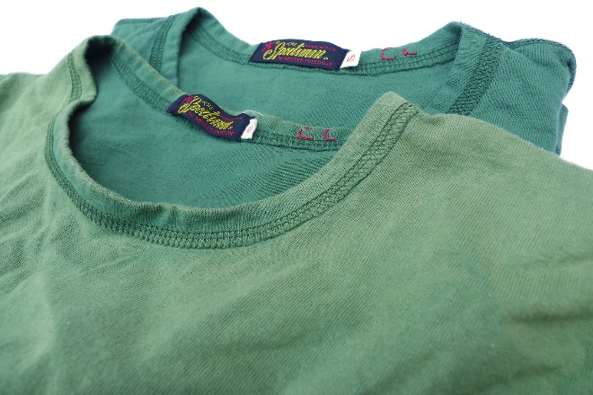

Lightfastness
  n.—The property of a material, usually an assigned number, depicting a ranked change in its color characteristics as a result of exposure of the material to sunlight or an artificial light source.
Notes:
5
May also be a change in strength, stretch, UV protection, or other properties. AATCC TM16.1, 16.2, 16.3 evaluate color change.

Slide 3
Factors
Dye susceptibility to photochemical degradation
Chemical nature of fading reaction (i.e., oxidative or reductive)
Degree of dye association or agglomeration in the fiber
Diffusion characteristics of the fiber
Chemical nature of the fiber
Light intensity and spectral power distribution
Environmental factors (e.g., temperature, relative humidity, atmospheric contaminants)
Contaminants, delustrants, UV stabilizers, finishes
Notes:
There have been a wealth of studies and articles written on the subject of light fading, and from those, a number of key factors affecting lightfastness have been identified.

Slide 4
Lightfastness Test Methods
  ISO 105-B02
  Textiles—Tests for colour fastness—Part B02: Colour fastness to artificial light: Xenon arc fading lamp test
  Multiple temperature/humidity options
    Exposure Cycle B similar to AATCC TM16.3, Option 3
  ISO blue wool standards for Exposure Cycles A1, A2, A3
  AATCC blue wool standards for Exposure Cycle B
Notes:
10

Slide 5
LightfastnessTest Methods
  SAE (Society of Automotive Engineers) J2412
  Accelerated Exposure of Automotive Interior Trim Components Using a Controlled Irradiance Xenon-Arc Apparatus
  Latest version published 2004-05-27
  Replaced J1885, which referenced specific instruments, in 2003
  Alternating light/dark cycles
  High temperature & humidity
Notes:
10

Slide 6
Lightfastness Test Methods
Lightfastness Test Methods (Xenon-Arc Exposure)
 | ISO 105-B02 (A1) | ISO 105-B02 (A2) | ISO 105-B02 (A3) | ISO 105-B02 (B) | SAE J2412 (Light/Dark) | AATCC TM16.3 (1, Light/Dark) | AATCC TM16.3 (2) | AATCC TM16.3 (3)
Black Standard Temp (°C) | 47 | 62 | 42 | 65 | _ | 70 | 60 | _
Black Panel Temp (°C) | 45 | 60 | 40 | 63 | 70/38 | _ | _ | 63
Humidity (%) | ~40 (EH) | <15 (EH) | ~85 (EH) | 30 (RH) | 50/95 (RH) | 35/90 (RH) | 30 (RH) | 30 (RH)
Duration (h) | _ | _ | _ | _ | 3.8/1 | 3.8/1 | _ | _
Irradiance (W/m²/nm) | 1.10 @420 nm | 1.10 @420 nm | 1.10 @420 nm | 1.10 @420 nm | 0.55 @340 nm | 1.10 @420 nm | 1.25 @420 nm | 1.10 @420 nm
Notes:
All methods listed use Xenon-Arc exposure.
ISO 105-B02 Exposure Cycle A1 (Normal/Temperate Zone)
ISO 105-B02 Exposure Cycle A2 (Extreme Low Humidity/Dry)
ISO 105-B02 Exposure Cycle A3 (Extreme High Humidity/Semi-tropical)
AATCC TM16.3, Option 1 (Alternating Light and Dark)
AATCC TM16.3, Option 2 (Continuous Light, Black Standard)
AATCC TM16.3, Option 3 (Continuous Light, Black Panel)
EH = Effective humidity
RH = Relative humidity

Slide 7
Ideal Exposure
Exact match to end-use conditions
Does not alter degradation mechanisms (results correlate with end-use)
Repeatable and reproducible
Independent control over all conditions
Quick

Slide 8
Real Exposure
5. Uses and Limitation
5.1 Not all materials are affected equally by the same light source and environment. Results obtained by the use of any one test option may not be representative of those of any other test option or any end-use application unless a mathematical correlation for a given material and/or a given application has been established. Enclosed Carbon-Arc, Xenon-Arc and Daylight have been extensively used in the trade for acceptance testing of textile materials. There may be a distinct difference in spectral power distribution, air temperature and humidity sensor locations, and test chamber size between test equipment supplied by different manufacturers that can result in differences in reported test results. Consequently, data obtained from equipment supplied by the different manufacturers, different test chamber size, or different light source and filter combinations cannot be used interchangeably, unless a mathematical correlation has been established. No correlations among differently constructed test apparatus are known to AATCC Committee RA50.
5.4 When using this test method, use a standard of comparison which has a known change in lightfastness after a specific exposure for comparison to the material to be tested. AATCC Blue Wool Lightfastness Standards have been used extensively for this purpose.
Notes:
The need to calibrate lightfastness test apparatus is as important today as it was 100 years ago!
Excerpt from TM16.1, 16.2 & 16.3 (same in all)

Slide 9
History
1921: AATCC founded, immediately began studying lightfastness
1930: First lightfastness method published, using natural sunlight
1941: First accelerated method using artificial light
Notes:
Lightfastness was the first major study funded by the Association.

Slide 10
Outdoor Exposure
AATCC TM16.1
Colorfastness to Light: Outdoor
  Behind glass
  Angle based on latitude
  Temp and humidity monitored, but not controlled
  Time consuming
  Subject to many
  variables
Notes:
Natural light exposures had two primary drawbacks. First, natural exposures took a long time to achieve any degree of fading. Secondly natural exposures are subject to many variables.

Slide 11
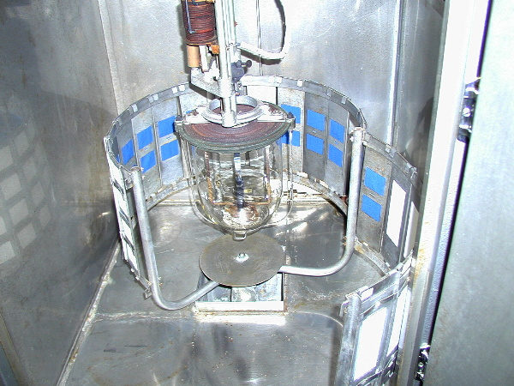
Carbon-Arc Exposure
AATCC TM16.2
Colorfastness to Light: Carbon-Arc
  Better repeatability than outdoor exposure
  Good (not great)
  control of temperature
  and humidity
  High UV intensity
  Continuous light and
  alternating light/dark
  options
Notes:
An early accelerated exposure procedures to gain prominence in industry relied on an enclosed Carbon Arc electrode apparatus. The photograph above was taken from a machine manufactured in the early 1960s.

Slide 12
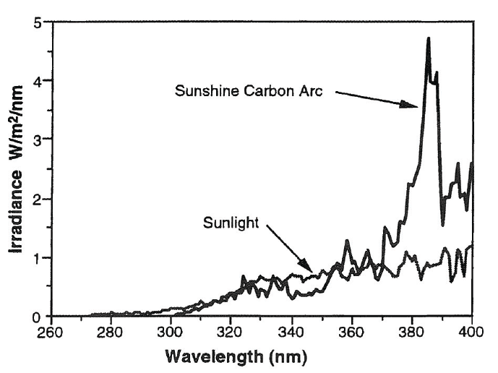
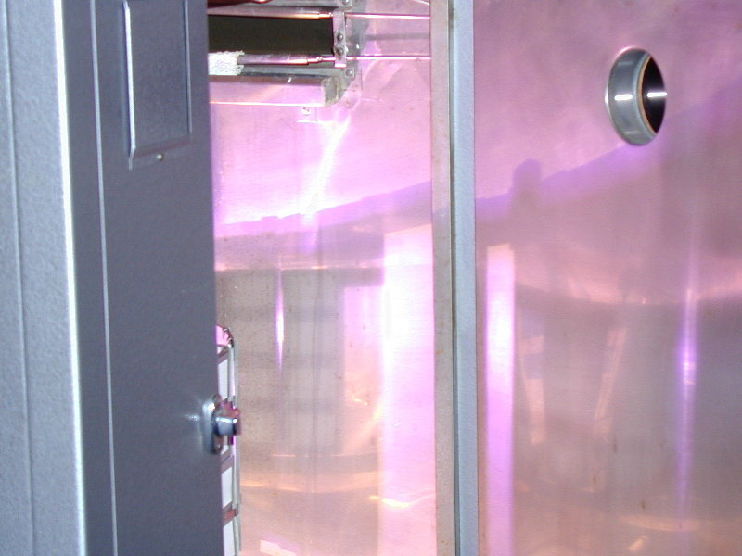
Carbon-Arc Exposure
Notes:
The spectral power distribution of carbon arc light compared to that of natural sunlight is higher in the ultraviolet region (100-400 nm) of the spectrum. UV is responsible for much of the textile fiber and dye degradation.
Photo was taken with the door of an enclosed carbon light apparatus open while in operation. (Never run a light fading apparatus with the door open!) Notice the violet reflection on the chamber walls.

Slide 13
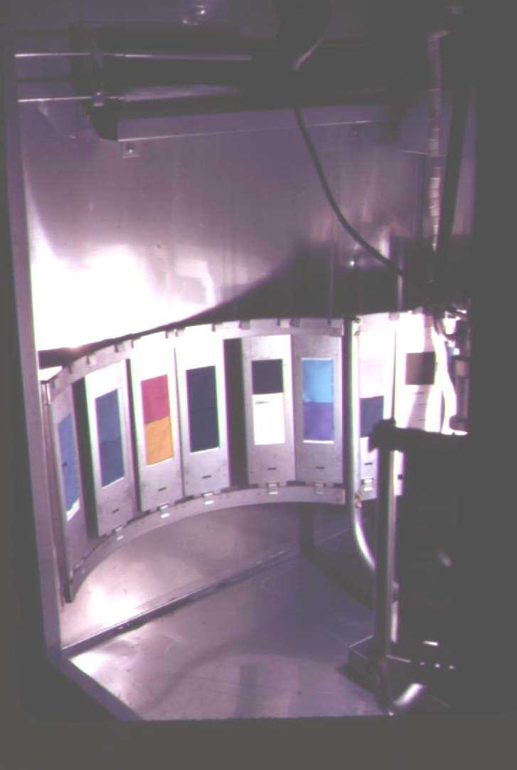
Xenon-Arc Exposure
AATCC TM16.3
Colorfastness to Light: Xenon-Arc
  SPD closer to that of natural sunlight
  No daily replacement
  of carbon electrodes
  Monitor and control
  light intensity
  Continuous light and
  alternating light/dark
  options
  Black standard and black
  panel options
Notes:
In 1964, AATCC published the first tentative test option (Test Method 16) using the new xenon arc lightfastness equipment that was being investigated at that time.
Notice the “whiter” reflection on the chamber walls when using a xenon lamp.

Slide 14
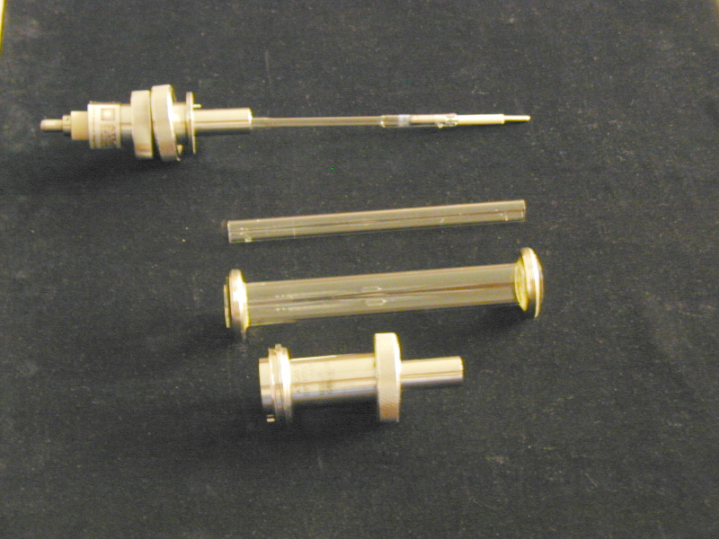
Xenon-Arc Exposure
Water-cooled xenon lamp
Xenon-filled burner tube
Inner filter
Outer filter
Housing assembly
Notes:
The combination of the glass filters, and the water that runs through them, results in an SPD similar to that of natural sunlight. (Water cools the lamp so it will not break. Lamps may also be air cooled.)

Slide 15
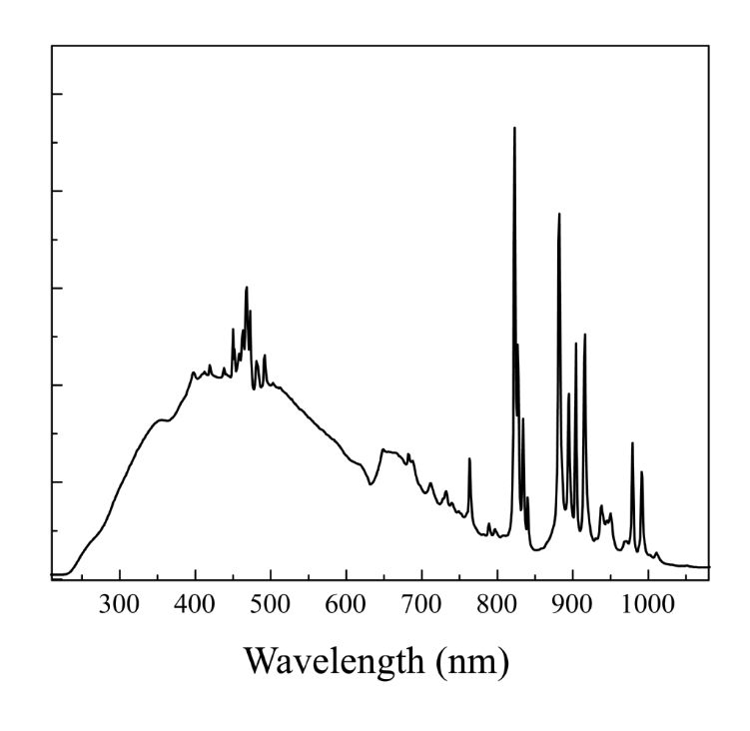
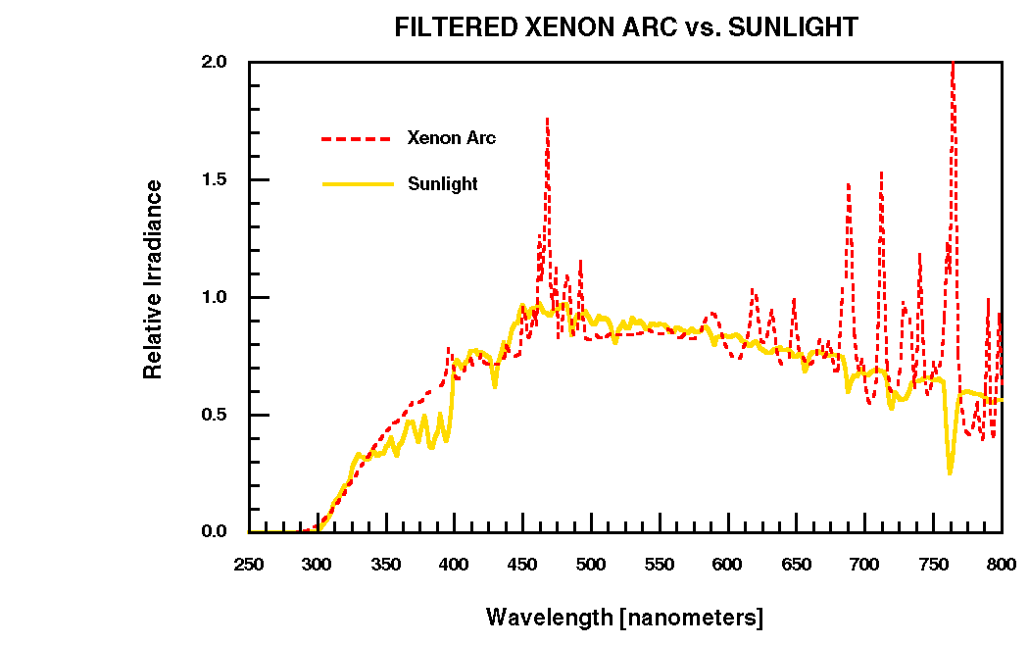
Xenon-Arc Exposure
Relative Irradiance (W/m² per nm)
Wavelength (nm)
Notes:
Less irradiance in the UV region than carbon-arc. Still not a perfect match for natural sunlight.

Slide 16
Controlling Irradiance
Irradiance exposure is affected by power and distance
  Power of a lamp decreases as it ages
  Distance depends on the position and thickness of the specimen
Notes:
24
A lamp controller helps maintain the same irradiance over time, at least at a given wavelength. (1.10 ±0.3 W/m²/nm at 420 nm for water cooled xenon lamps)
Temperature and humidity are also controlled. These do not affect irradiance, but can have separate effects on lightfastness.

Slide 17
Controlling Irradiance (Distance)
20 cm
150,000,000 km
2 cm
9 km
Irradiance received on the surface of an exposed specimen is inversely proportional to the squares of the distances from the source.
(Distance₁)²
Irradiance =
(Distance₂)²
Notes:
In an light machine, a slight change in distance between the lamp and specimens can have a dramatic effect on the fading results.
A specimen extending 2 cm beyond the specimen holder will receive 1.23 times (123%) the irradiance reported by the machine.
1.23 = (20)²/(20-2)²
Specimens exposed at any point (or elevation) on the earth’s surface will not be affected by distance. A specimen at the top of Mt Everest will receive 1.00000006 (6 x 10⁻⁸ % more) times (6 x 10⁻⁸ % more) the irradiance received by a specimen at sea level.
1.00000006 = (1.5 x 10⁸)²/(1.5 x 10⁸ - 9)²
Changes in latitude WILL affect the duration of exposure, temperature, and humidity.

Slide 18
Controlling Irradiance (Distance)
Rotating rack
Inclined rack
Lamp calibration (specific to machine diam.)
Specimen holders secured to rack at top and bottom
Specimens mounted flat in holders
Test in triplicate, distribute specimens
Blue Wool Lightfastness Standards

Slide 19
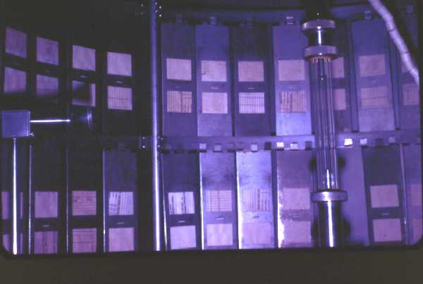
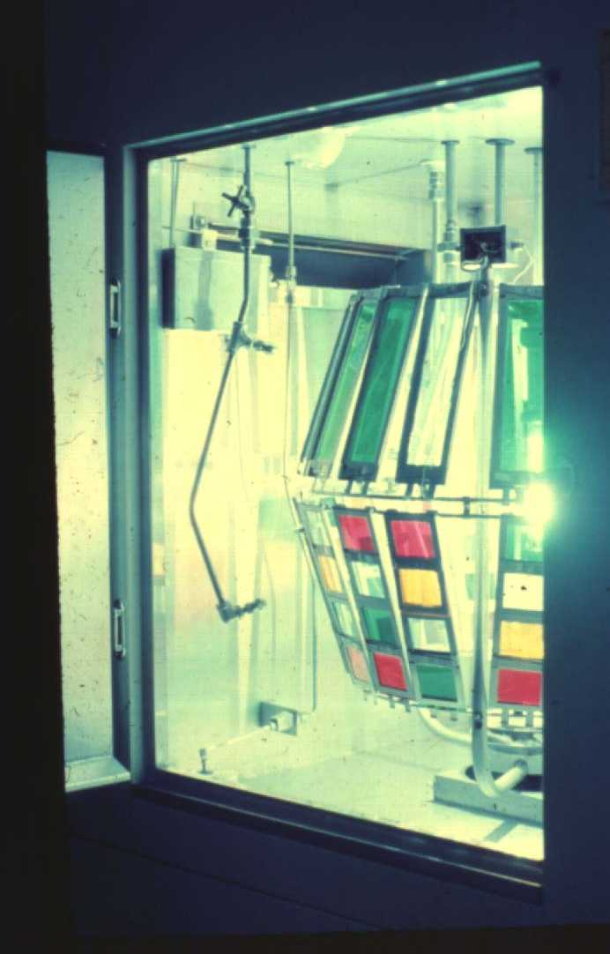
Controlling Irradiance (Distance)
Notes:
Single-tiered racks hold fewer specimens, but the specimens are kept in approximately the same horizontal plane and distance from the lamp. Variations in distance from the lamp to the specimens can have a significant impact on fading.
Note that the double-tiered rack can hold more specimens, but the top most positions and bottom most positions on the rack will be slightly further from the lamp and those positions will receive less total irradiation. When using this type of rack, if possible position the specimens and control fabrics in the bottom portion of the top rack or the upper portion on the bottom rack.
The inclined-rack was developed to negate the difference in irradiation received at the top and bottom portions of the rack.

Slide 20
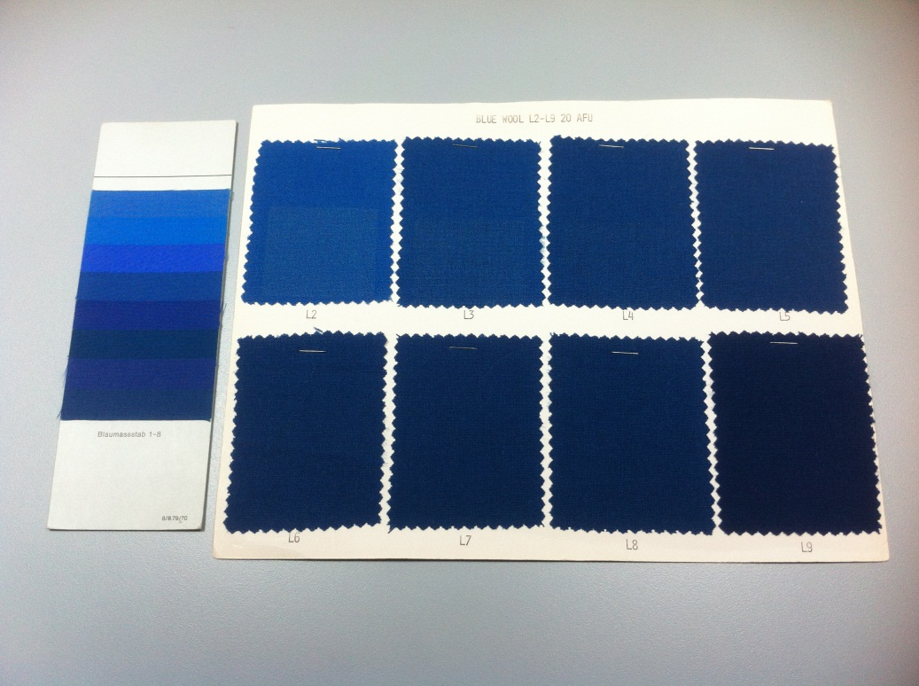
Blue Wool
Lightfastness Standards
ISO
AATCC
Notes:
ISO and AATCC standards are not interchangeable.
The AATCC series was shown to be more linear and less sensitive to heat, but most of the series is no longer available.
Developed in the 1940s, AATCC Blue Wool Lightfastness Standards ranged from the L2 standard, made from wool fibers stock dyed with a very fugitive dye, to the L9 Standard, from wool fibers stock dyed with a very lightfast dye. L3 through L8 Blue Wool Lightfastness Standards used fugitive- and lightfast- dyed fibers blended in various ratios. Each standard takes twice as long to fade as the previous.
The lightfast dye is no longer commercially available. More recent lots of L2 have used a dye similar to the original fugitive dye (same CI#, different manufacturers), but were piece dyed instead of stock dyed.

Slide 21
AATCC Fading Unit (AFU)
n.—a specific amount of exposure made under the conditions specified in various test methods where one AFU is one twentieth (1/20) of the light-on exposure required to produce a color change equal to Step 4 of the Gray Scale for Color Change or 1.7 ± 0.3 CIELAB units of color difference on AATCC Blue Wool Lightfastness Standard L4.
Notes:
See ASTM G151 Significance statement regarding correlation between lab test and real world use.

Slide 22
AATCC Blue Wool
AFU and Irradiance for Step 4 Color Change
AATCC Blue Wool Standard | AFU | kJ/m²/nm @ 420 nm (Xenon-Arc)
L2 | 5 | 21
L3 | 10 | 43
L4 | 20 | 85
L5 | 40 | 170
L6 | 80 | 340
L7 | 160 | 680
L8 | 320 | 1360
L9 | 640 | 2720
20 AFU was established at 85 kJ/2/nm @ 420 nm based on experimental data using the conditions in TM16.3 to achieve a Step 4 color change of L4. Other values were extrapolated.
Notes:
From Table I of TM16.1, 16.2, 16.3. Irradiance also measured at 300-400 nm
Each higher numbered AATCC Blue Wool Standard is twice as colorfast as the preceding number.

Slide 23
AATCC Blue Wool
Only L2 currently available
5 AFU end point (Gray Scale Step 4)
20 AFU end point (Gray Scale Step 2-3)
Use with appropriate Standard of Fade (match L designation, lot, and end point)
Replace as needed during test to measure any multiple of 5 or 20 AFU
Notes:
Revisions in 2014 to clarify use of L2 for 20AFU tests.

Slide 24
Black Thermometer
Sensing unit coated black to absorb most of the radiant energy (≥ 95%)
Provides estimate of maximum temperature a specimen may attain during exposure
Keep black face in good condition
Black-panel thermometer and black standard thermometers are NOT interchangeable

Slide 25
Black Thermometer
Black Panel Thermometer
Black Standard Thermometer
Uninsulated
Metal
Mounted on specimen rack
Typically reads lower
ISO 105-B02, SAE J2412, AATCC TM16.2, AATCC TM16.3 (Option 3)
Insulated
Metal with plastic backing
Mounted on specimen rack
Typically reads higher
AATCC TM16.3 (Options
1 & 2)

Slide 26
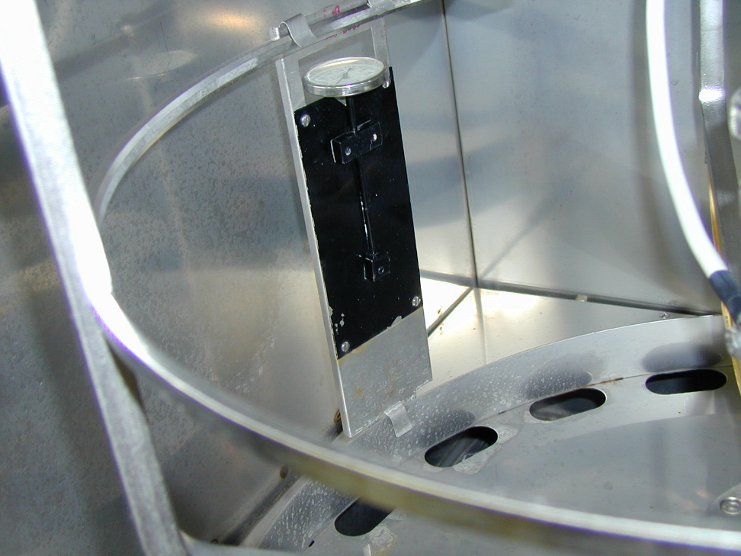
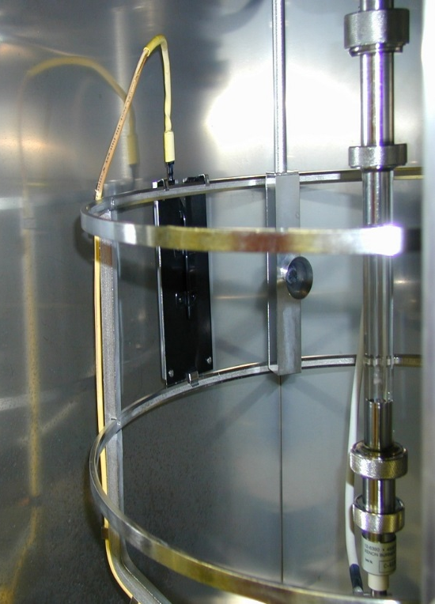
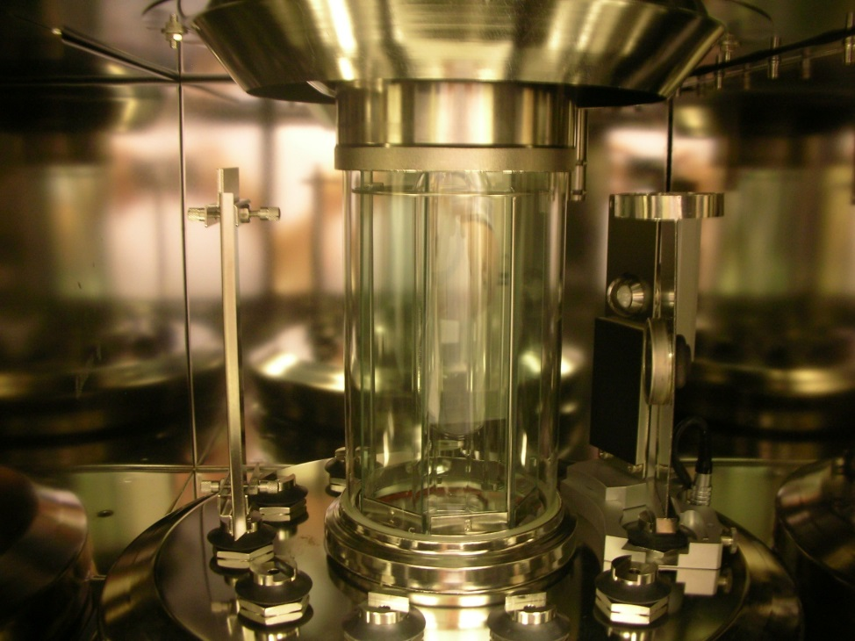
Black Thermometer
Black Panel Thermometer
Black Standard Thermometer
Notes:
Dial black panel thermometer is an older style. Newer devices are electronic.
Black standard shows a machine set up for ISO test

Slide 27
Xenon Arc Chamber Interior
Notes:
It’s important to have uniform air flow in the test chamber so as to keep the temperature of the test specimens as close to the set temperature as possible. Fill rack, using white cardstock in holders if necessary.

Slide 28
AATCC TM16.3
Colorfastness to Light: Xenon-Arc
Option 1: Xenon-Arc Lamp, Alternate Light and Dark
Option 2: Xenon-Arc Lamp, Continuous Light, Black Standard Option
Option 3: Xenon-Arc Lamp, Continuous Light, Black Panel Option
Notes:
Major revision of TM16 in 2012.
Split into three separate methods (16.1, 16.2, 16.3)
Text was reorganized and revised for each part.
A flow chart for conducting each part is included in the Appendix of each one.
Xenon Reference Fabric was removed from the test methods. (Originally used to verify temperature in the test chamber.
Kept the old TM16 Option 3 the same (TM16.3 Option 3) to minimize confusion. This is the most commonly used option.

Slide 29
AATCC TM16.3, Option 3
Cut 70.0 x 120.0 mm specimens
  Warp in long direction
  Three of each test material
  Three standard (Blue Wool) specimens
  For yarn, wind to cover 25.0 x 150.0 mm

Slide 30
AATCC TM16.3, Option 3
Mount specimens in frames
  Back specimens with white, non-reflecting cardboard
  Mount cardboard-only specimens to fill rack
  Do not compress specimens unnecessarily
  Ensure sharp line between exposed and unexposed areas
  If used, masks should be nearly lightproof
  Exposed area ≥ 30 x 30 mm
Notes:
Backing with white cardboard reduces the temperature variability caused by air flow through the textile materials and should produce more repeatable results.
Masks “approaching zero light transmittance.”
Expose ≥ 40.0 x 50.0 mm for pile specimens (fibers may shift or texture may make evaluation of small areas difficult).
Expose sufficient size or multiple specimens to include all colors of the specimen.
See 44.8 for frame details (dull finish, conform to curve of rack, coated non ferrous staples)

Slide 31
AATCC TM16.3, Option 3
Verify machine operation
  Set operating conditions
  Place black panel thermometer in rack
  Fill rack with mounted cardboard-only specimens
  Adjust while operating:
    Black panel temperature
    Chamber air temperature
    Relative humidity
Notes:
(Turn off spray units)

Slide 32
AATCC TM16.3, Option 3
Light source: Xenon, Continuous light-on
Black panel temperature: 63 ±1° C
Chamber air temperature: 43 ±2° C
Relative humidity: 30 ±5%
Irradiance:
  1.10 ±0.03 W/m²/nm @ 420 nm
  48 ±1 W/m² @ 300-400nm
Notes:
The fading machine will have been run in the preparation and calibration phase to ensure these conditions can be maintained prior to running the actual test with test specimens. These same conditions must also be maintained during the actual running of the test for Option 3.

Slide 33
AATCC TM16.3, Option 3
Verify exposure with AATCC Blue Wool Lightfastness Standards
  Expose mounted L2 specimens for 20 ±2 hours
  Compare to L2 Standard of Fade for 20 AFU
  Adjust lamp wattage, exposure time, or both and repeat test until exposed specimens match standard of fade
Notes:
Keep settings verified in previous step. Keep rack filled with cardboard specimens.
28.1 calls for verification with L4
28.2 is alternate method with L2
Instrumental irradiance settings allow for better initial approximation, but still require verification.
If required exposure is > 22 hours, consider replacing lamp or other manufacturer calibrations.

Slide 34
AATCC TM16.3, Option 3
Expose test and reference specimens to a specified amount of radiant energy
  Select appropriate reference standard
  Simultaneously expose mounted test specimens and mounted reference specimens
  Run test to desired end point
    Stop to replace reference specimen as needed
    Minimize interruptions for specimen or lamp replacement
  Remove & condition specimens in dark room
Notes:
AATCC Blue Wool is the preferred reference standard. L-designation should be selected based on desired AFU exposure.
End point calculated from run time or irradiance in previous step (L2/20 AFU exposure).
If there are not enough test specimens to fill the rack, the extra holders should be filled with white cardstock.

Slide 35
AATCC TM16.3, Option 3
Evaluate color change between exposed and unexposed areas of test specimen
  Gray Scale for Color Change (EP1 or EP7)
  ΔE_{CIELAB}, ΔL*, ΔC*, ΔH*
Notes:
L = lightness
C = chroma
H = hue

Slide 36
AATCC TM16.3, Option 3
Alternate end points:
  Two-step method
  Lightfastness classification
Notes:
Two step: expose to a specified AFU, then cover one half and expose to a second end point (provides “complete characterization”).
Classification: Expose test specimens with full series. When test specimen reaches Gray Scale Step 4, determine which standard exhibits the most similar change.
Two-step classification: After reaching Step 4, cover half and continue to Step 3.

Slide 37
AATCC TM16.3, Option 3
Report:
  Test method and option
  Lightfastness rating
  Reference standard
  Ambient temperature
  Black panel temperature
  Means of controlling exposure
  Total radiant energy
  Type of apparatus, rack, water supply
  Total exposure time
  Deviations
Notes:
Control exposure using blue wool, radiant energy, etc.

